Slide 1




Premier Furniture
Prepared by:
Kholoud Nashaat
Marina Shaker
Maryam Mohamed
Nermeen Reda
Rawan Khouder
Toqa Mamdouh
Reham Moawad
Zaher Sheban
Monitored by: Dr. Elwy Rady
17/10/2024

Slide 2
Table of contents
01
02
03
04
05
06
Store before Odoo
Project idea
Tools used
Business Process
Implementation
Store after Odoo

Slide 3

Shop before using Odoo
01
1. Manual Processes:
Premier Furniture used paper records or simple spreadsheets to track sales, inventory, and customer information.
Sales: No clear tracking of orders, difficulty in following up with clients.
Inventory: Manual stock tracking, leading to overstock or stock shortages.
CRM: Lack of customer management, no organized follow-up, and missed opportunities for sales.
2.Challenges:
Delays in fulfilling customer orders. .
Inaccurate stock counts.
Inefficient communication with customers.

Slide 4
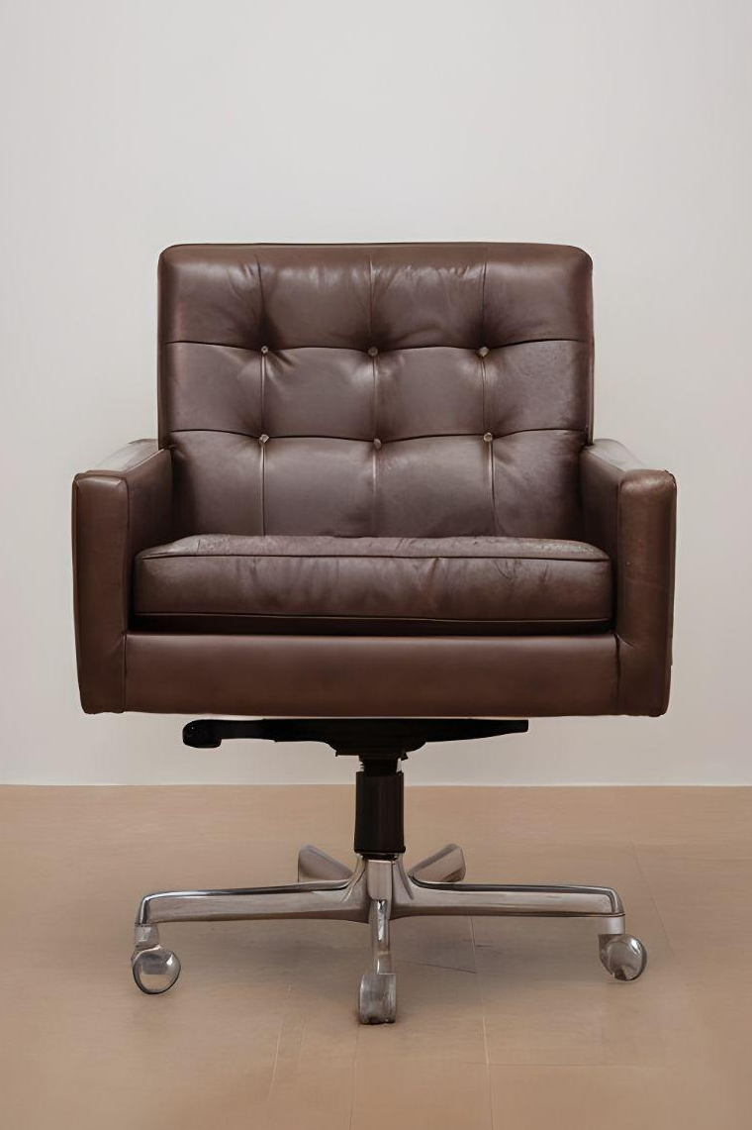
Project idea
02
Implement Odoo’s Sales, Inventory, and CRM modules to improve efficiency and streamline operations.
Sales Module: Automate order processing, invoice creation, and payment tracking.
Inventory Module: Enable real-time inventory management, tracking stock levels, and triggering automatic reorder points.
CRM Module: Build better relationships by capturing leads, tracking communication, and offering personalized services to clients.

Slide 5



Tools used
03
Odoo ERP system
Software
It offers a wide range of integrated modules covering essential areas.
A suitable operating system for the servers
Hardware
Network
-Vary as needed.
-Client devices, Servers, Storages ….etc.
Secured network
and
Sufficient bandwidth

Slide 6

Business Process
04

Slide 7
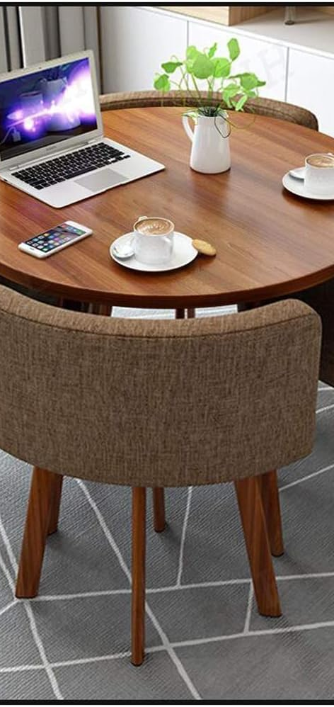
1) Implementation type
2) Budget
3)Timeline
Phased Implemetation: the system is implemented in stages, often starting with specific departments or regions.
30,000 – 50,000 EGP
10 – 12 weeks
4) Services
Developing and installation the system.
Testing and monitoring the efficiency.
Training the involved employees

Slide 8
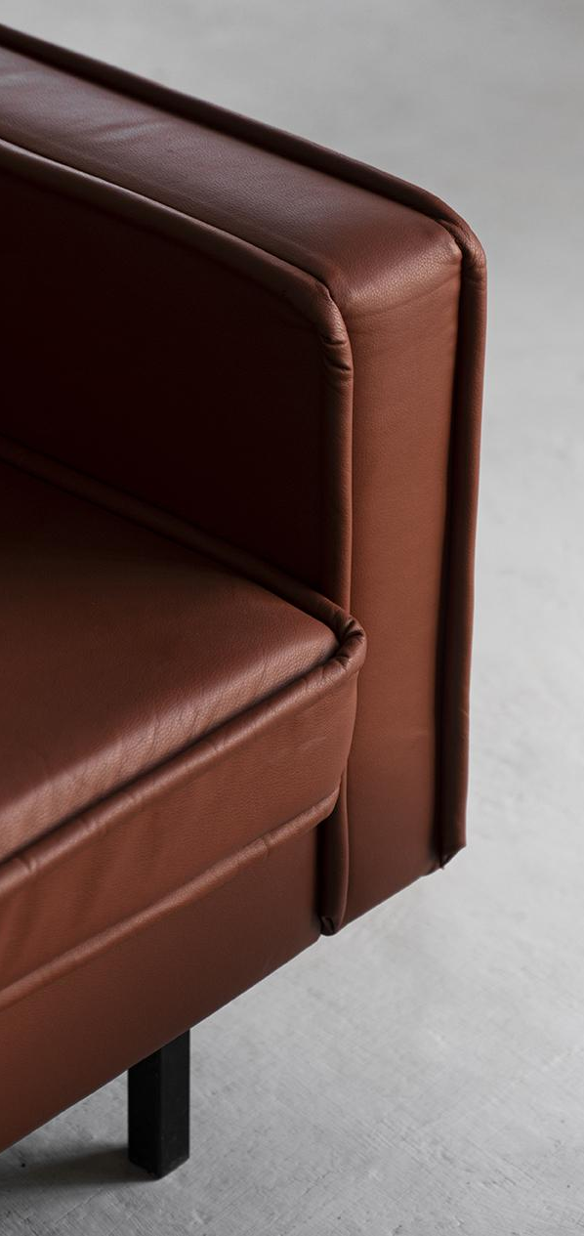
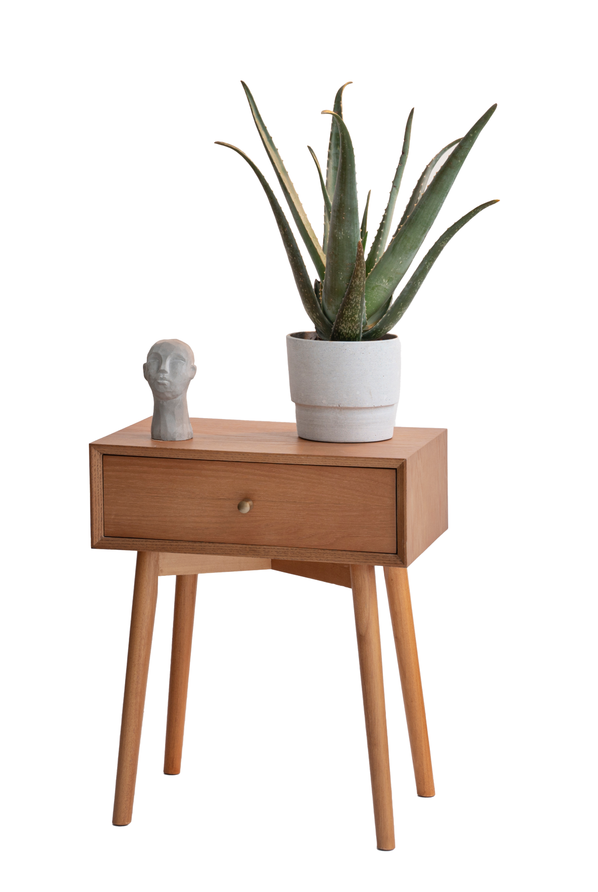
05
Implementation
“An idea is nothing its implemetation is everything”
~ Aleksandr Kronrod

Slide 9
Inventory module
Client Complaint:
Difficulty in managing inventory and inability to track within warehouses.
Solution:
1
Install inventory management module
Prepare the company’s product data with Excel & upload to google
5
3
Establish a dedicated company database
Configure the module to address the company’s issues
Ensure the compatability of product attributes with the store’s products
4
2

Slide 10
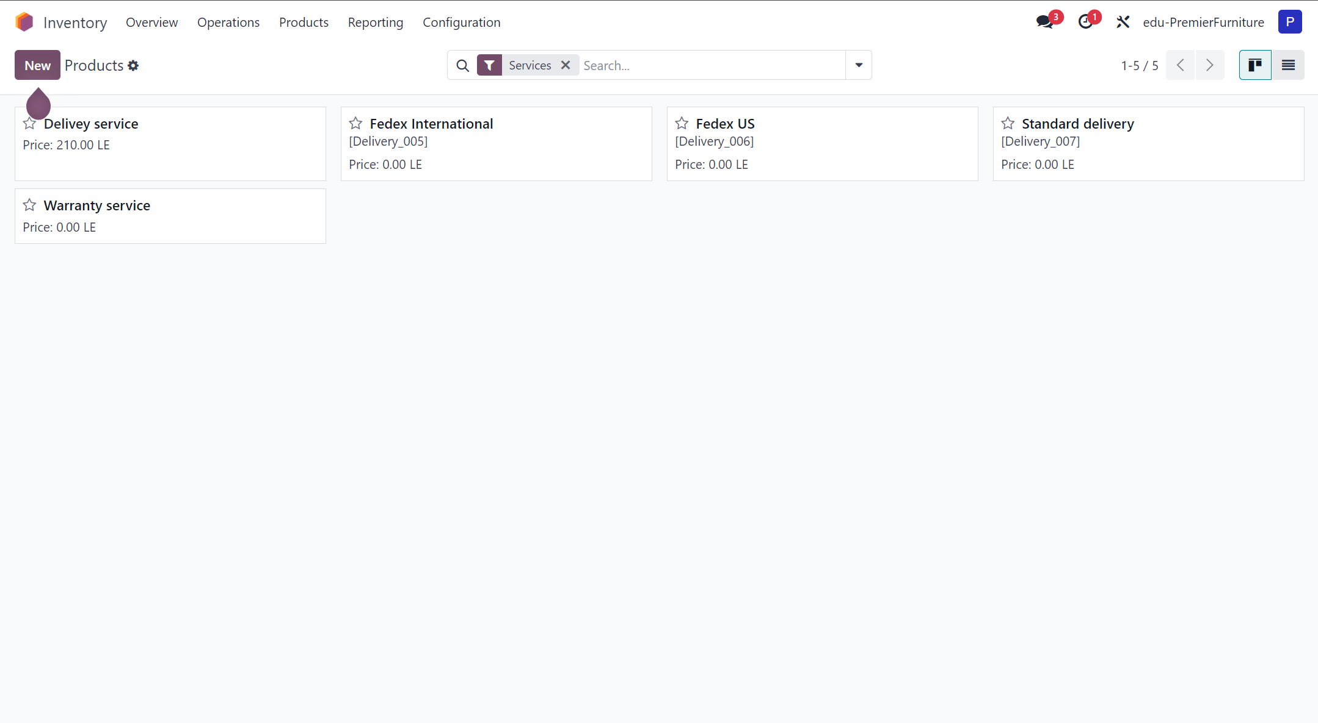
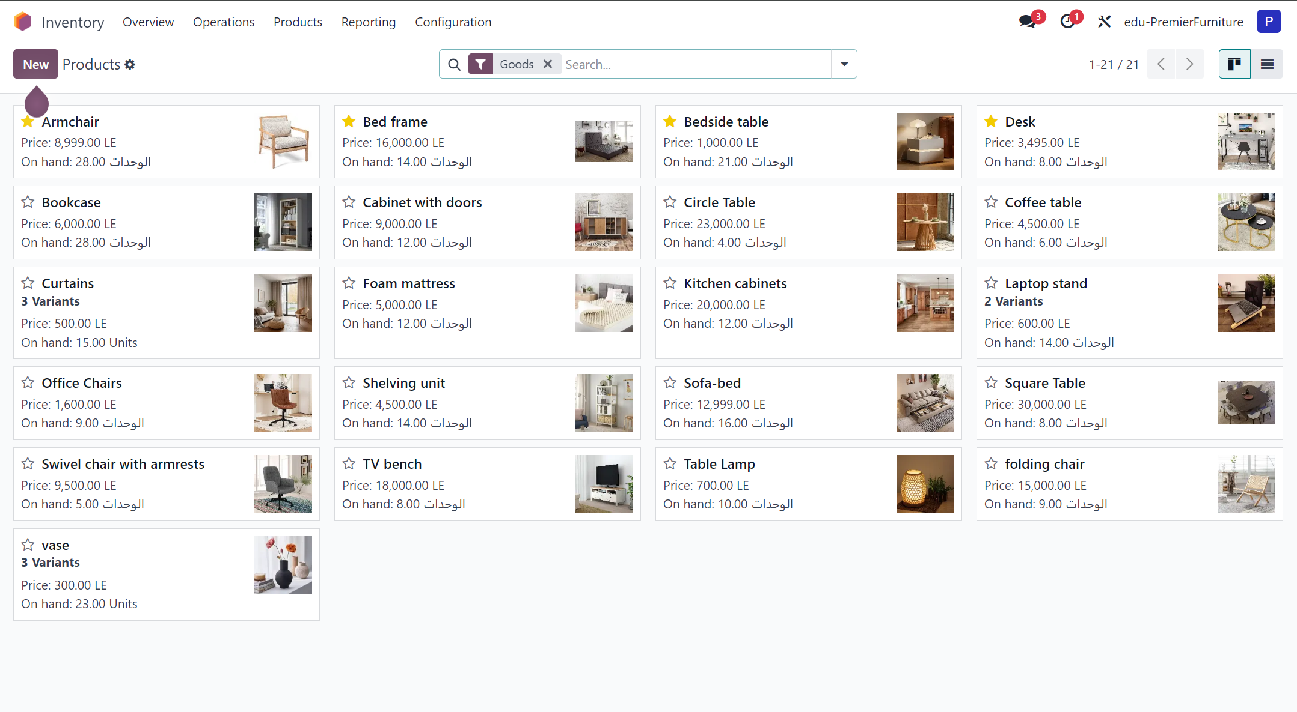
1)Product Management

Slide 11
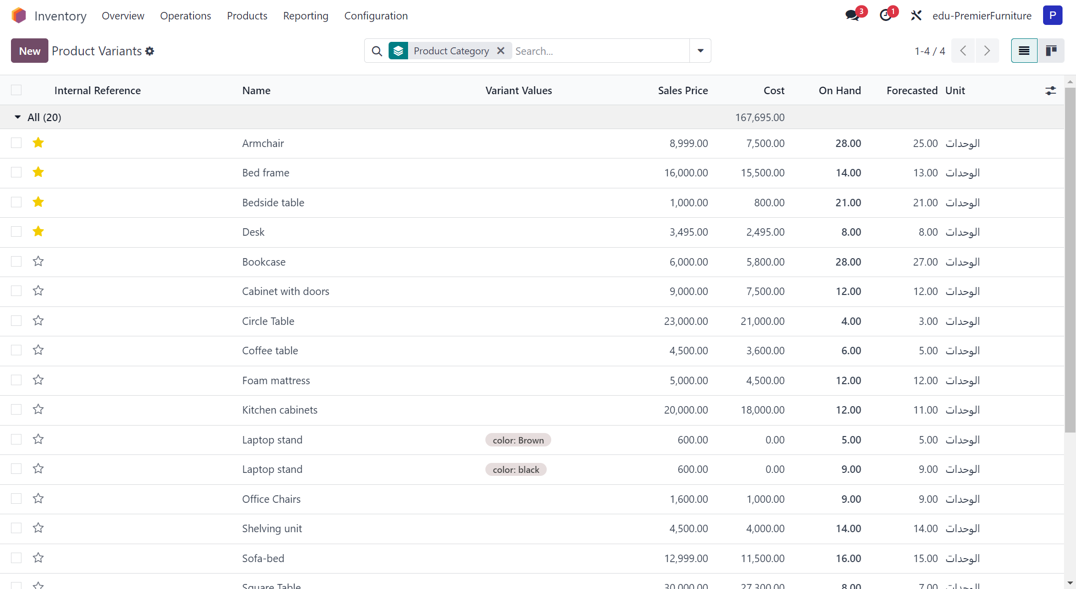
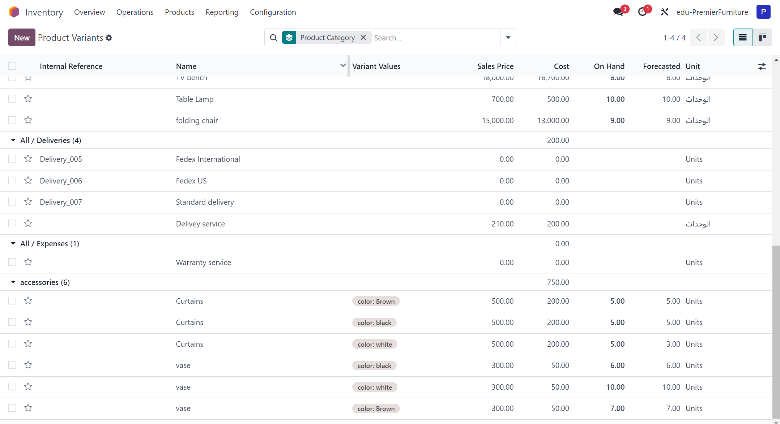
2)Inventory Tracking

Slide 12
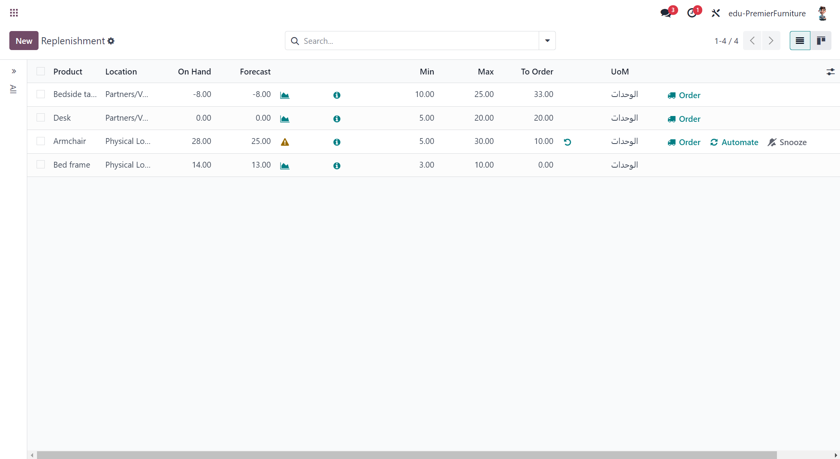
3)Replinshment

Slide 13
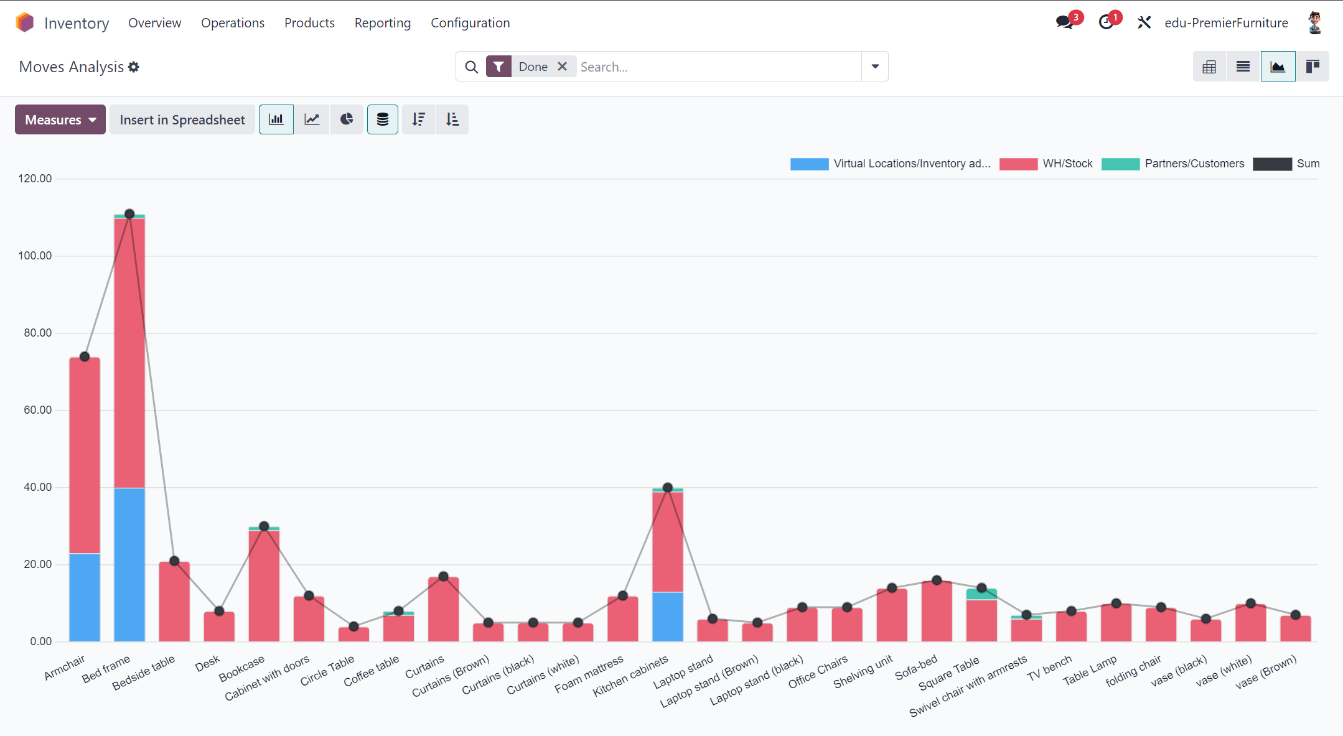
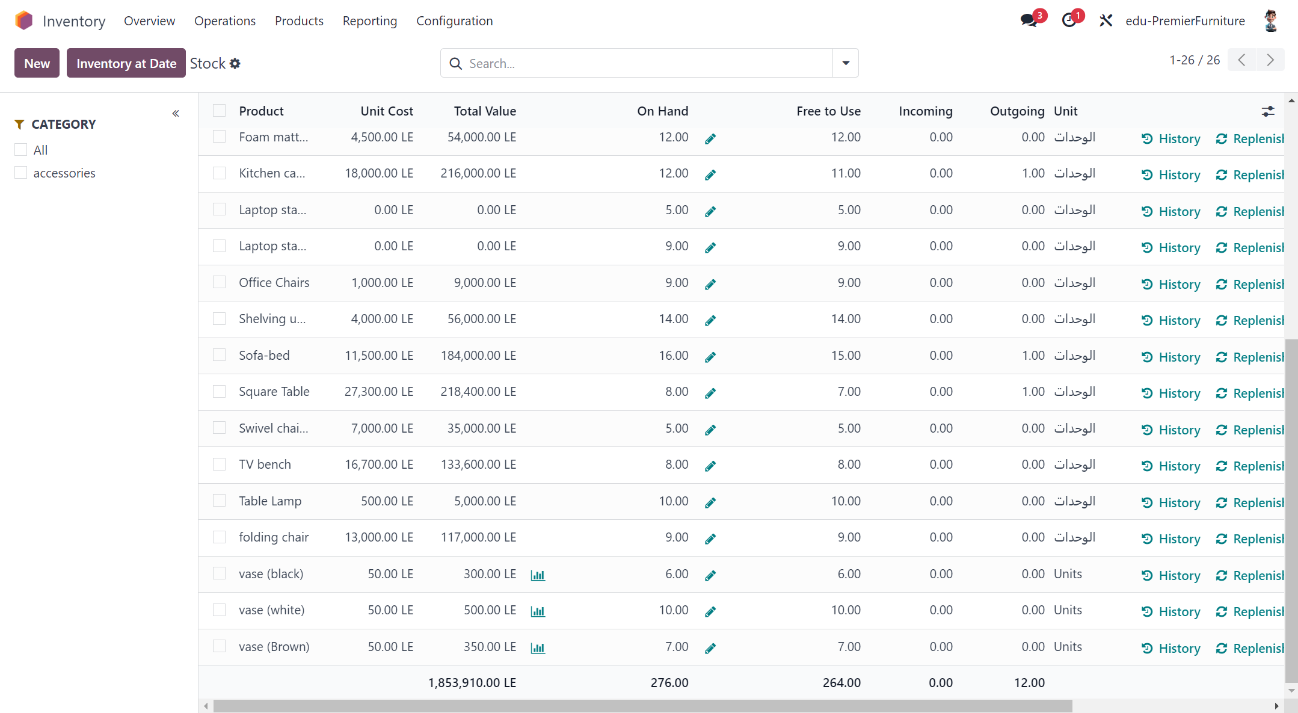
4)Reporting

Slide 14
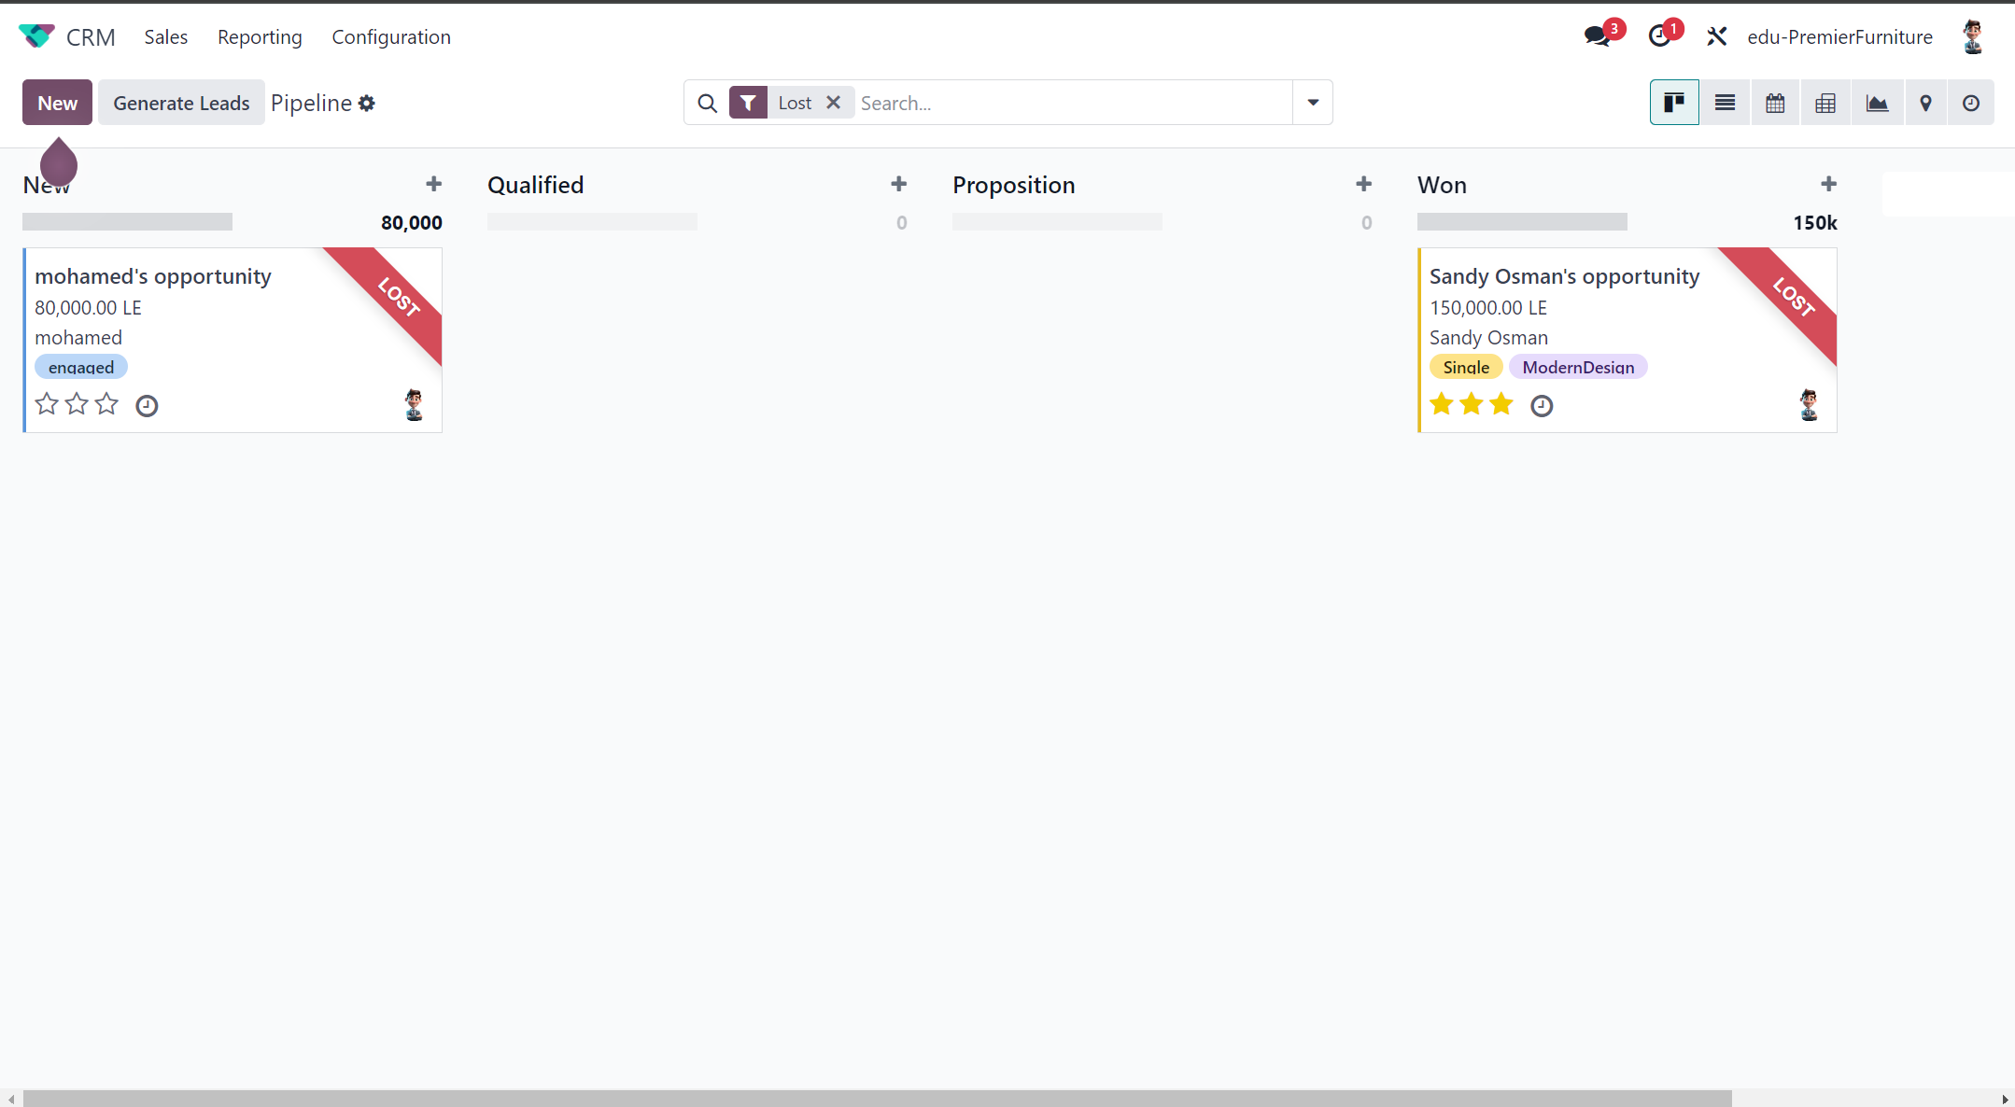
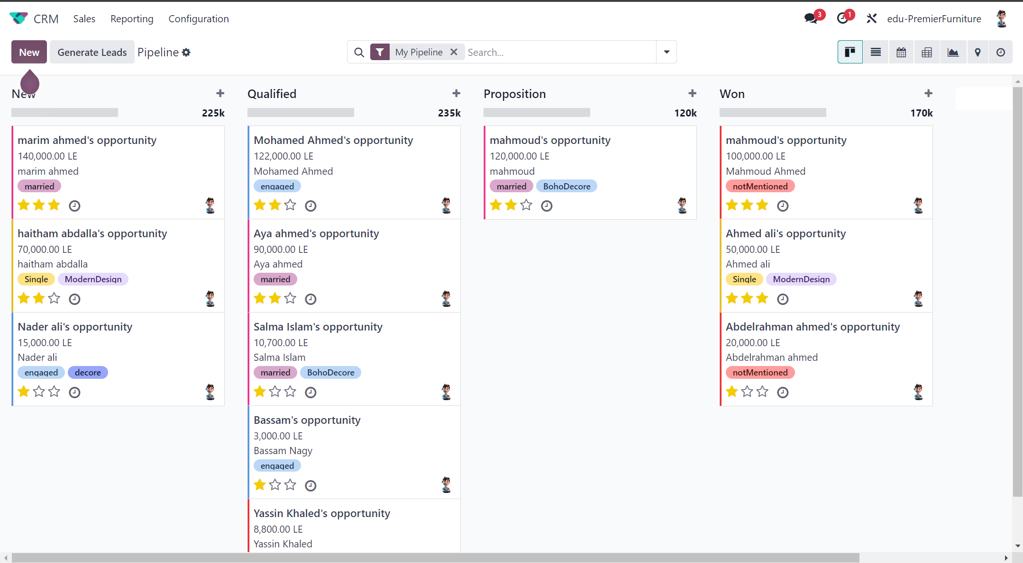
CRM module
Lack of customized and personalized products
Limited furniture types and designs

Slide 15
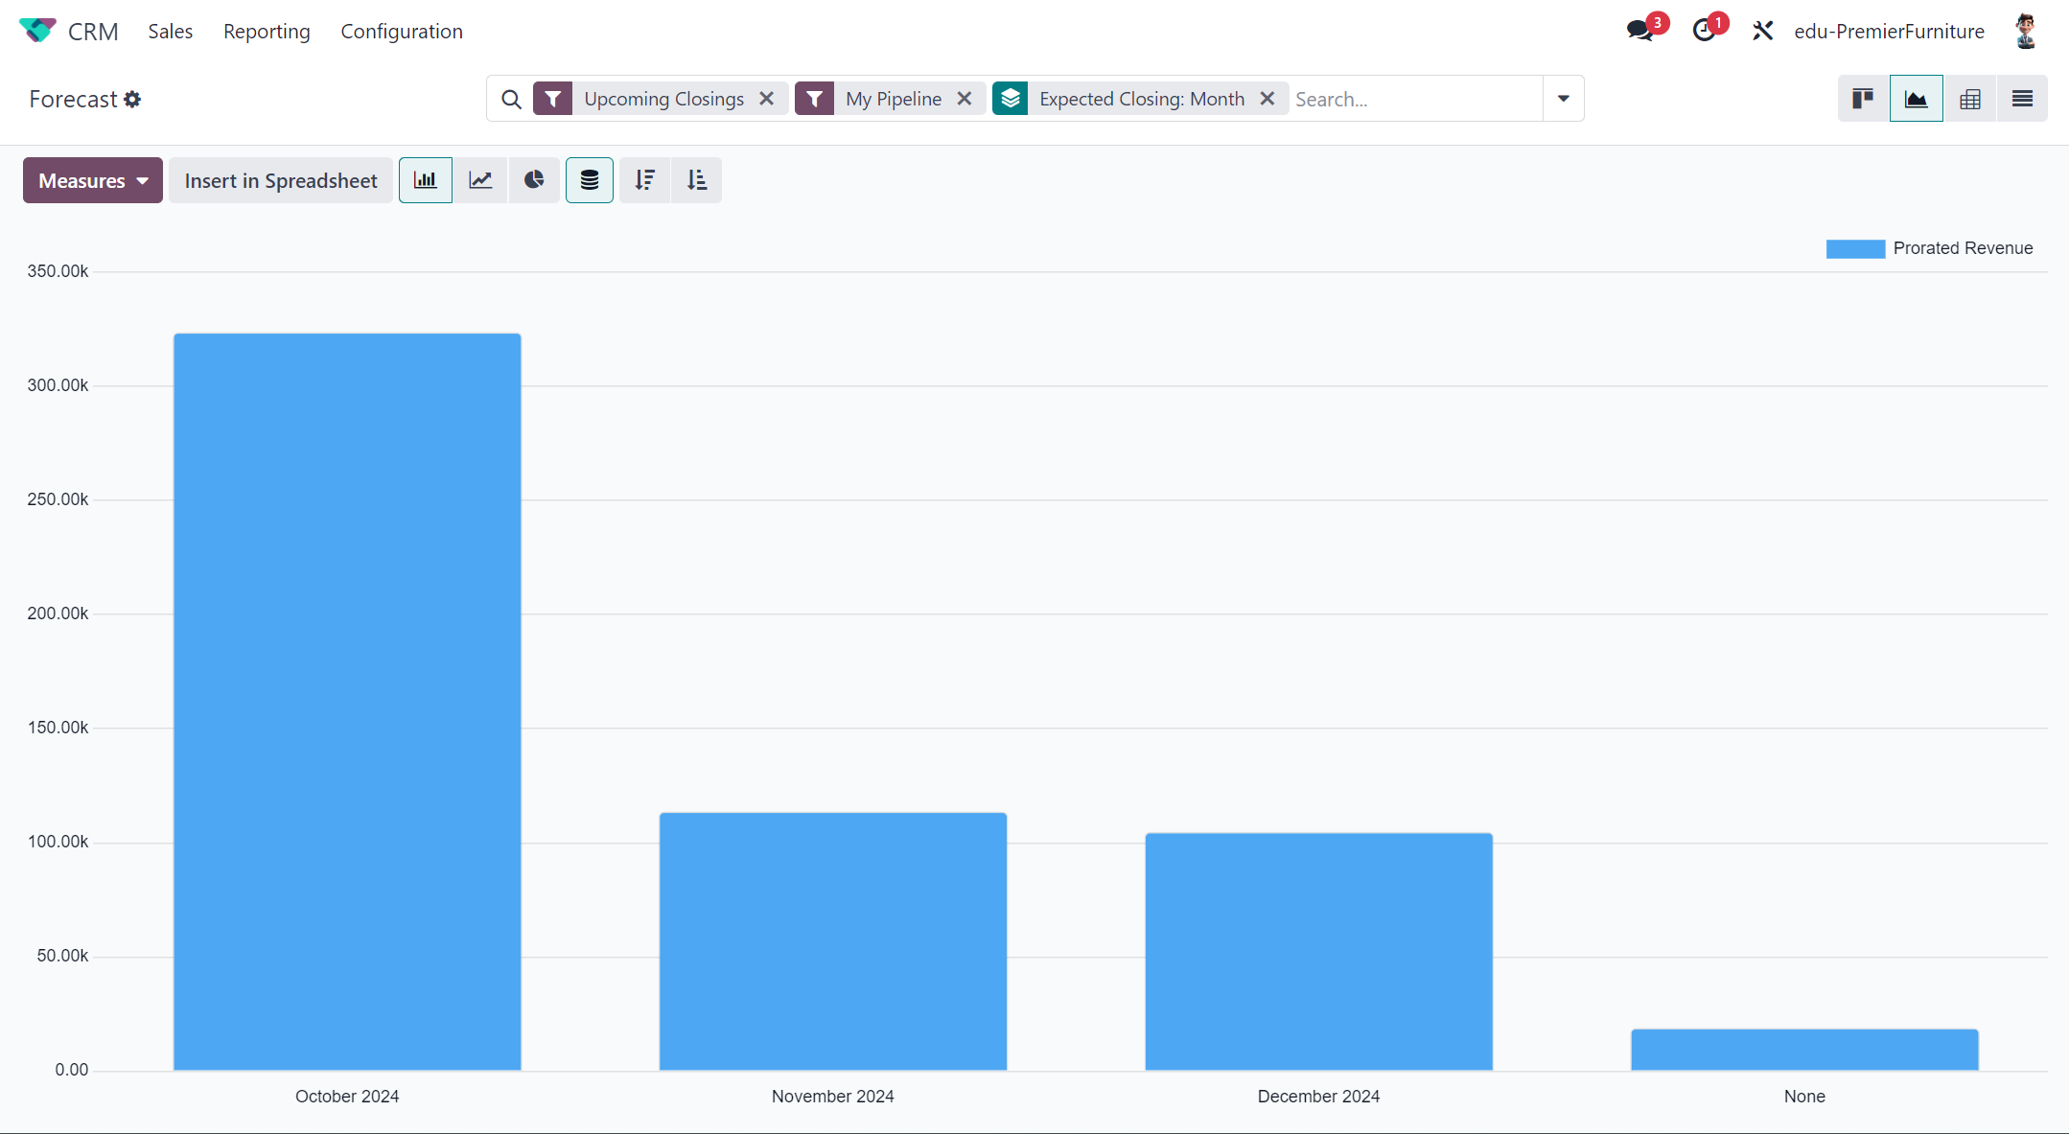
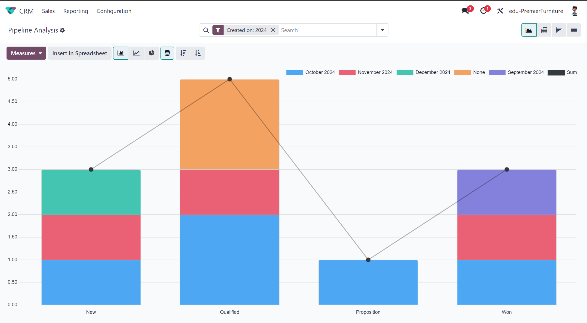
2) Reporting

Slide 16
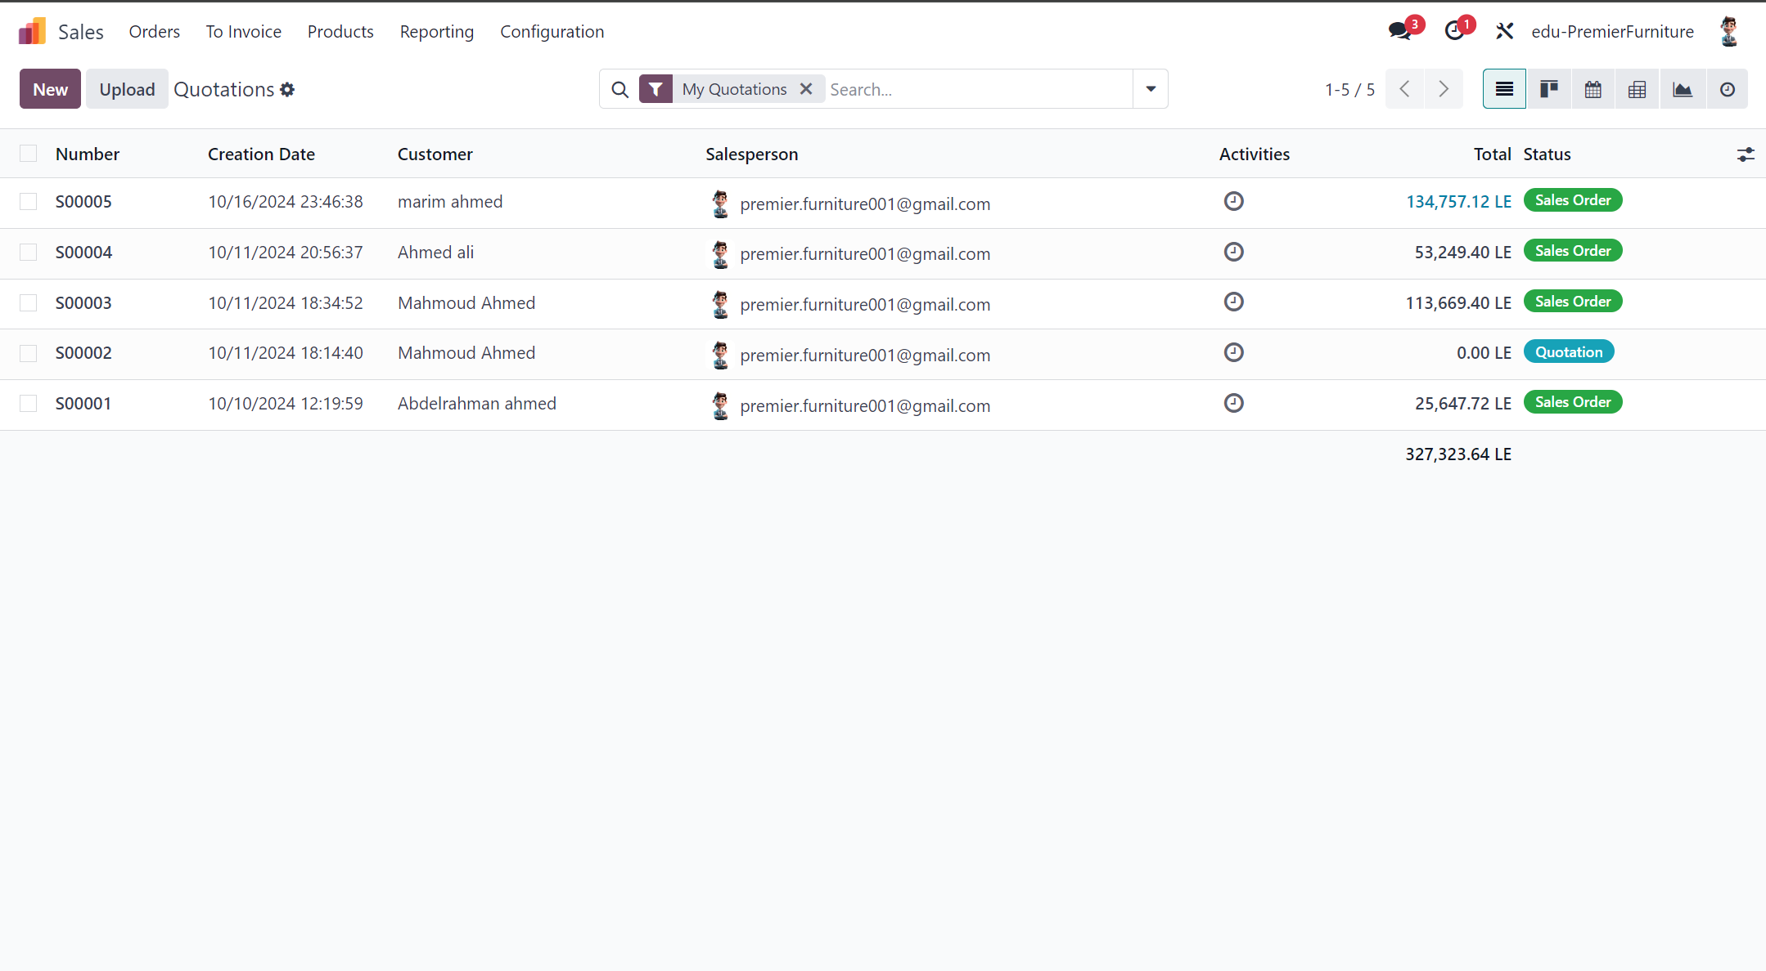
Sales module

Slide 17
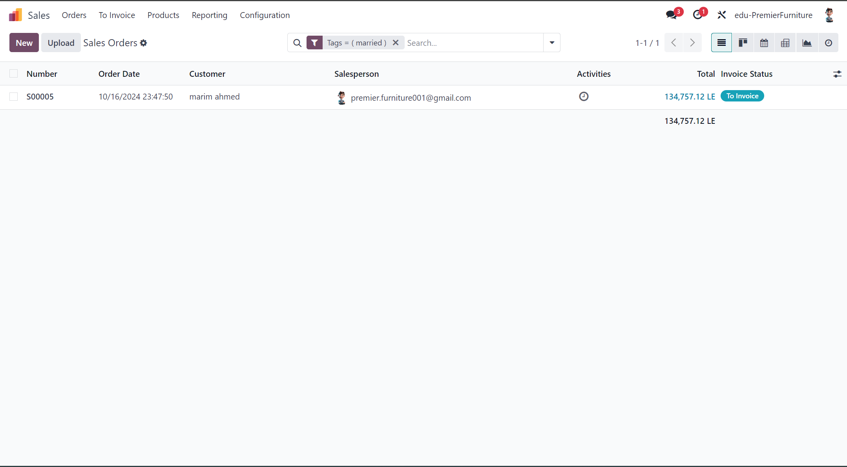
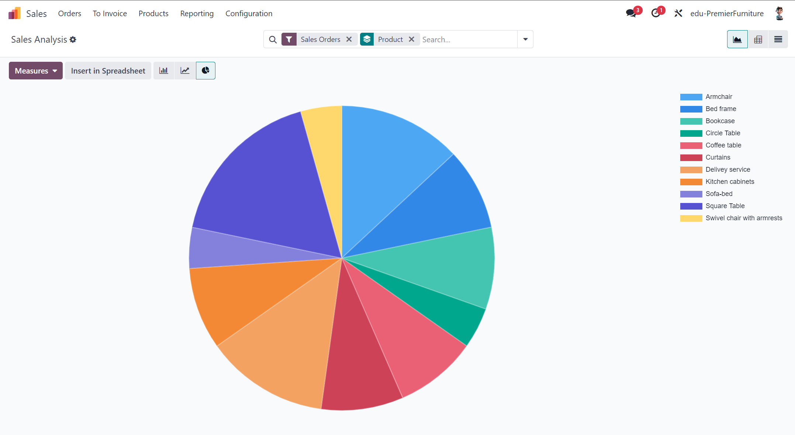
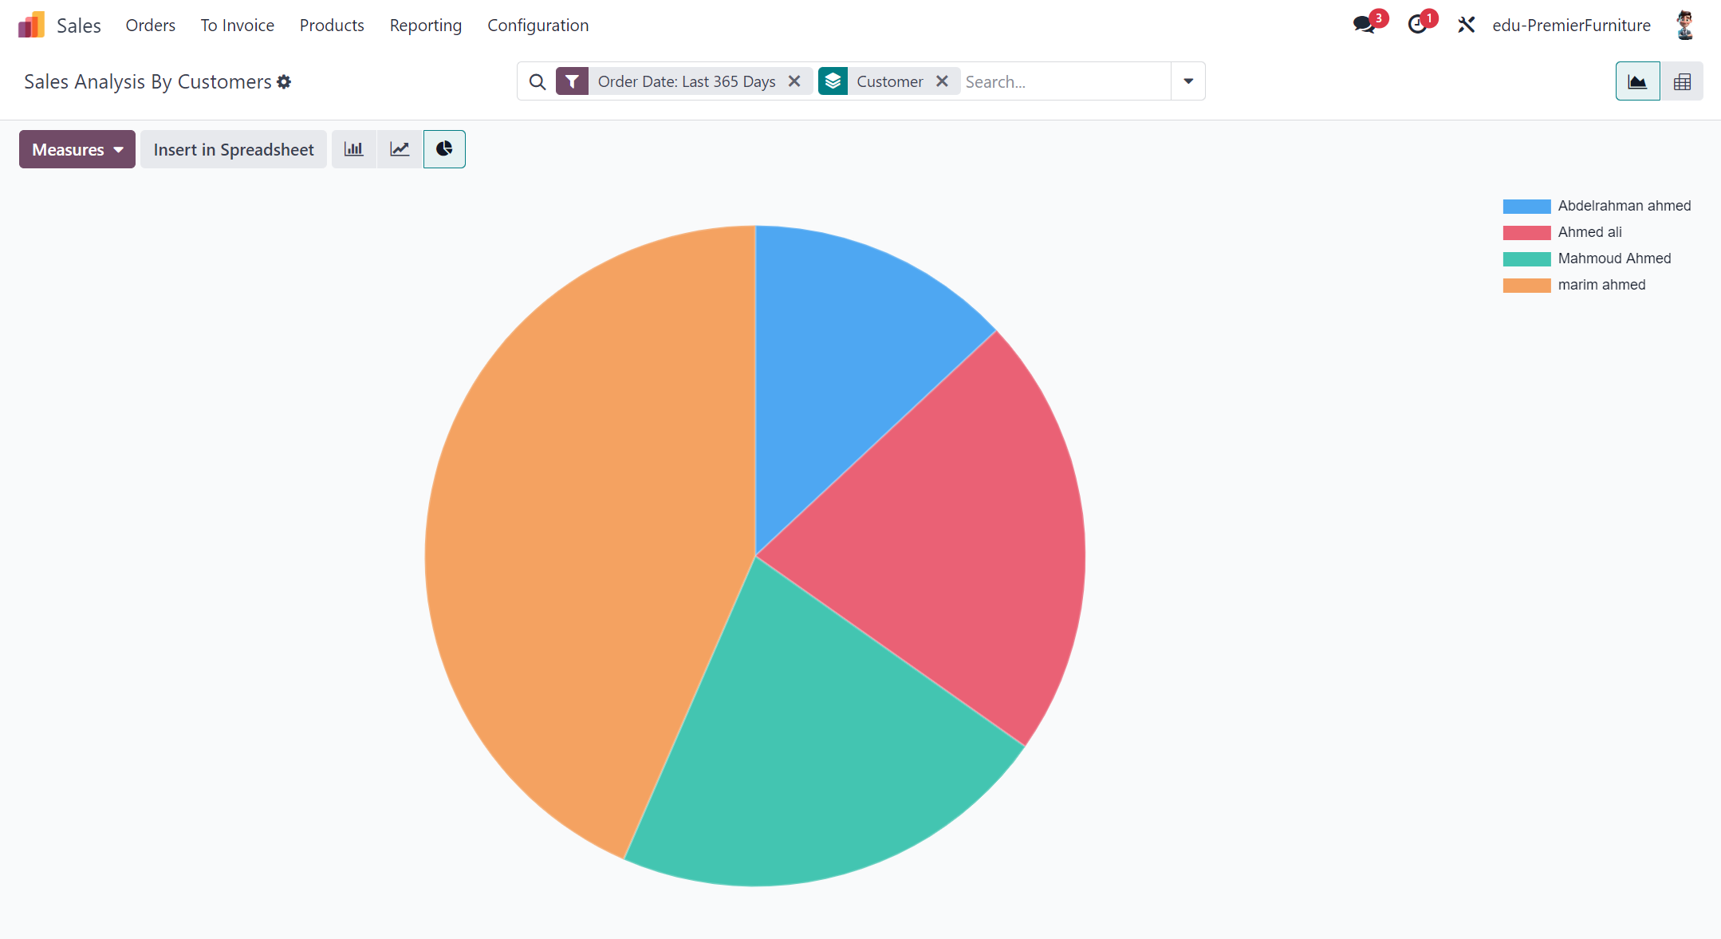
2) Reporting

Slide 18
Premier furniture after using Odoo
Improved Sales Process
Streamlined Inventory Management
06
Orders are now processed faster, with automatic tracking of customer information and preferences.
Improved customer satisfaction due to quicker response times.
Easier sales forecasting through Odoo’s analytics tools.
Real-Time Tracking which is Odoo provides instant visibility into stock levels, enabling better inventory decisions.
Reduced overstock and stock shortages.
Automatic reordering when stock is low.
Clear overview of incoming and outgoing stock movements.

Slide 19
Premier furniture after using Odoo
Enhanced customer relationship management
Conclusion
05
With Odoo’s CRM module, Premier Furniture now captures leads, tracks communications, and nurtures relationships with potential customers.
Odoo transformed Premier Furniture’s operations by automating and optimizing their sales, inventory, and CRM processes which is
Increased efficiency, better customer experience, and more accurate inventory management, all contributing to business growth.

Slide 20

THANK YOU!
Any questions?

